Slide 1
doing research with digital images.
Image Sorter and
Clarifai API interface
Carlo De Gaetano | DSS Summerschool 2019

Slide 2
https://bit.ly/31xmcXn
Notes:
At this lin you can find the presentation

Slide 3
requirements
https://bit.ly/31xmcXn
Install Google Chrome
Install TabSave extension
Download Image sorter (mac) (here Windows)
Create an account on Clarifai and get an API Key
Download Bbedit || Notepad++ or simply use Apple TextEdit
Add to your browser Google Image URLs Extractor
(if the described procedure isn’t working, wait for explanation)
Notes:
For attending this tutorial you should have been installed some softwares and extension on your laptop: Google Chrome, TabSave Extension, the Google Image URLS Extractor, Image Sorter

Slide 4
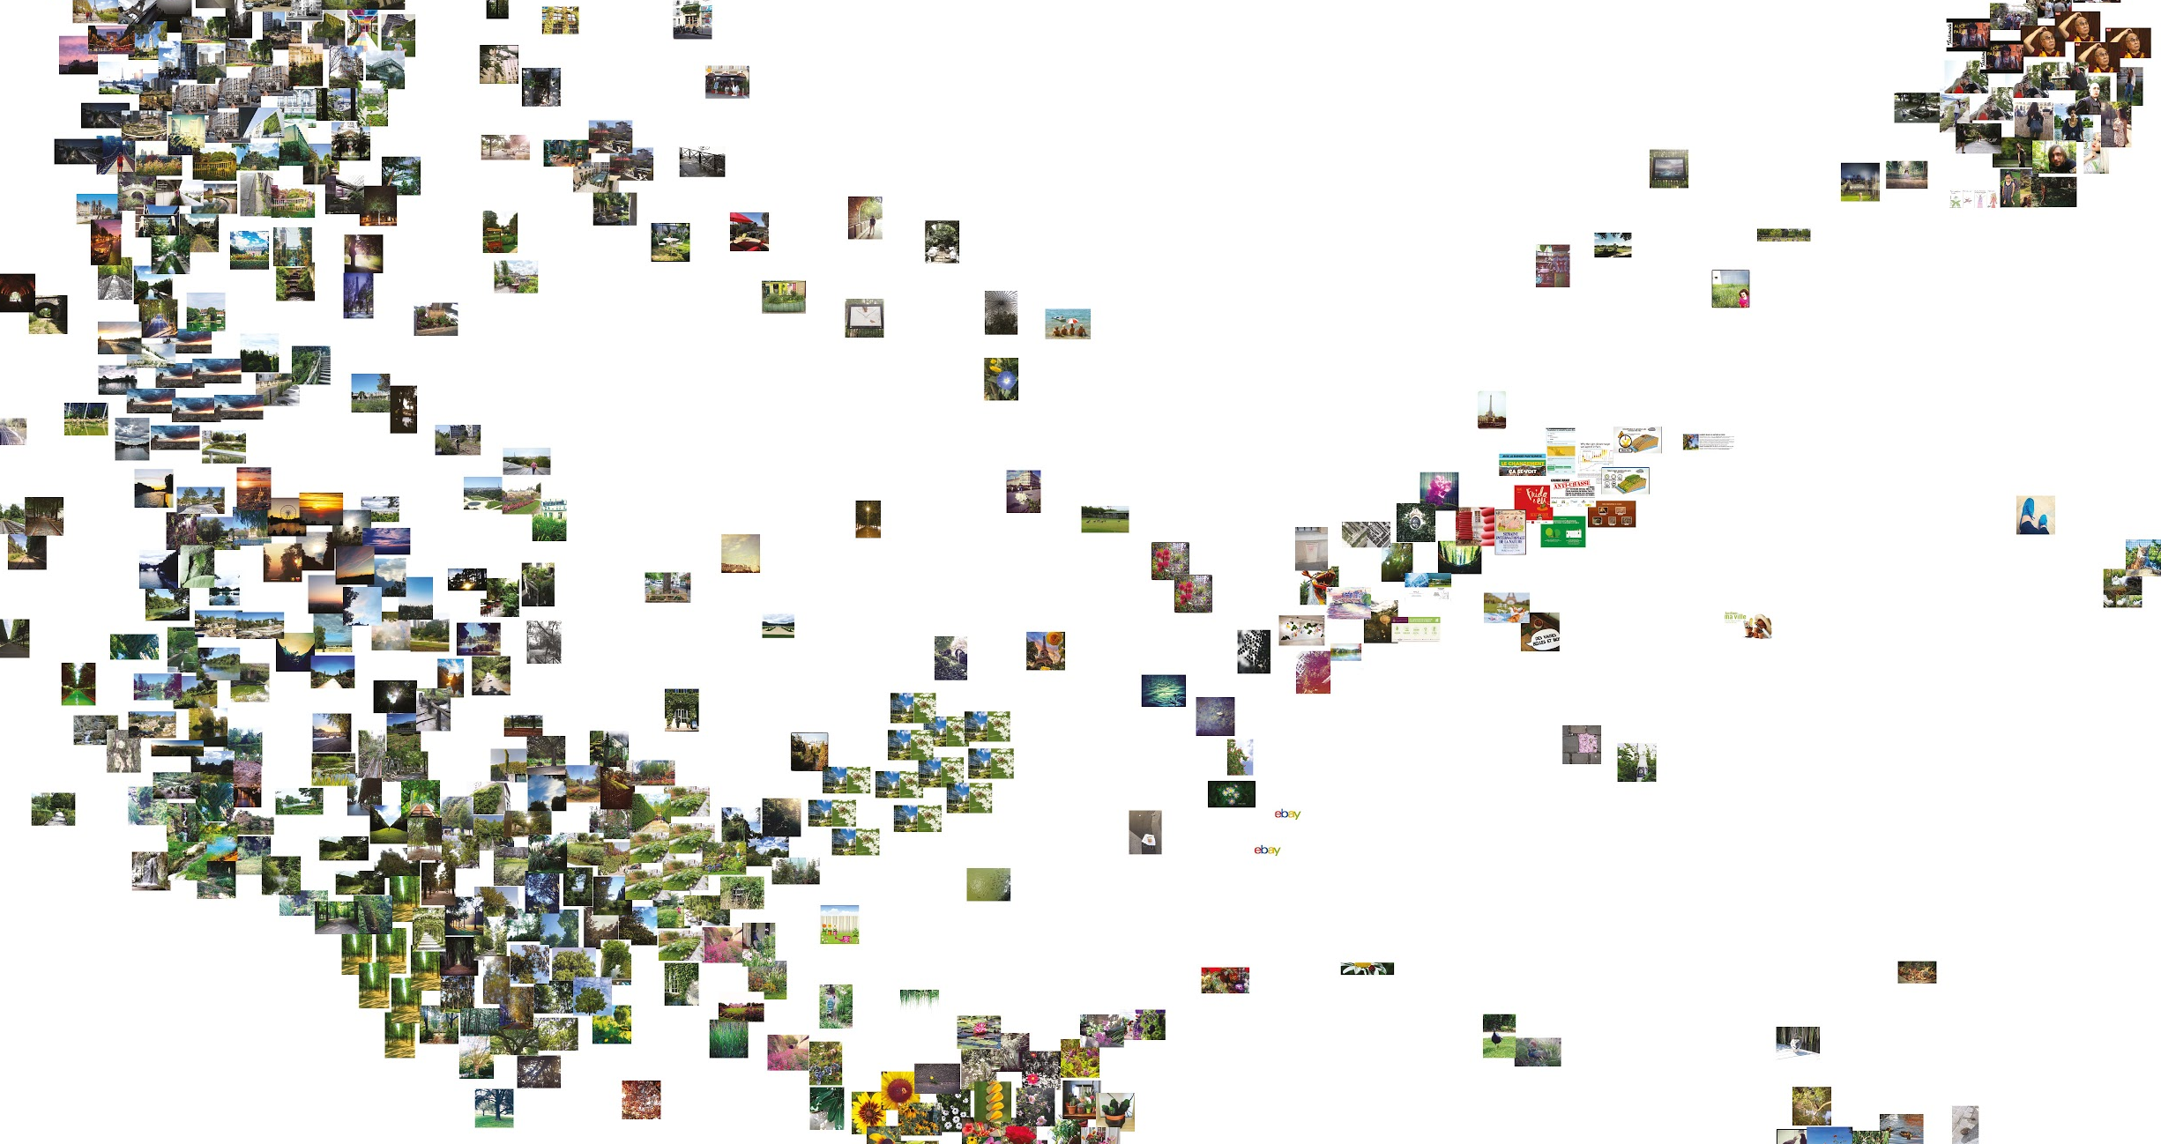
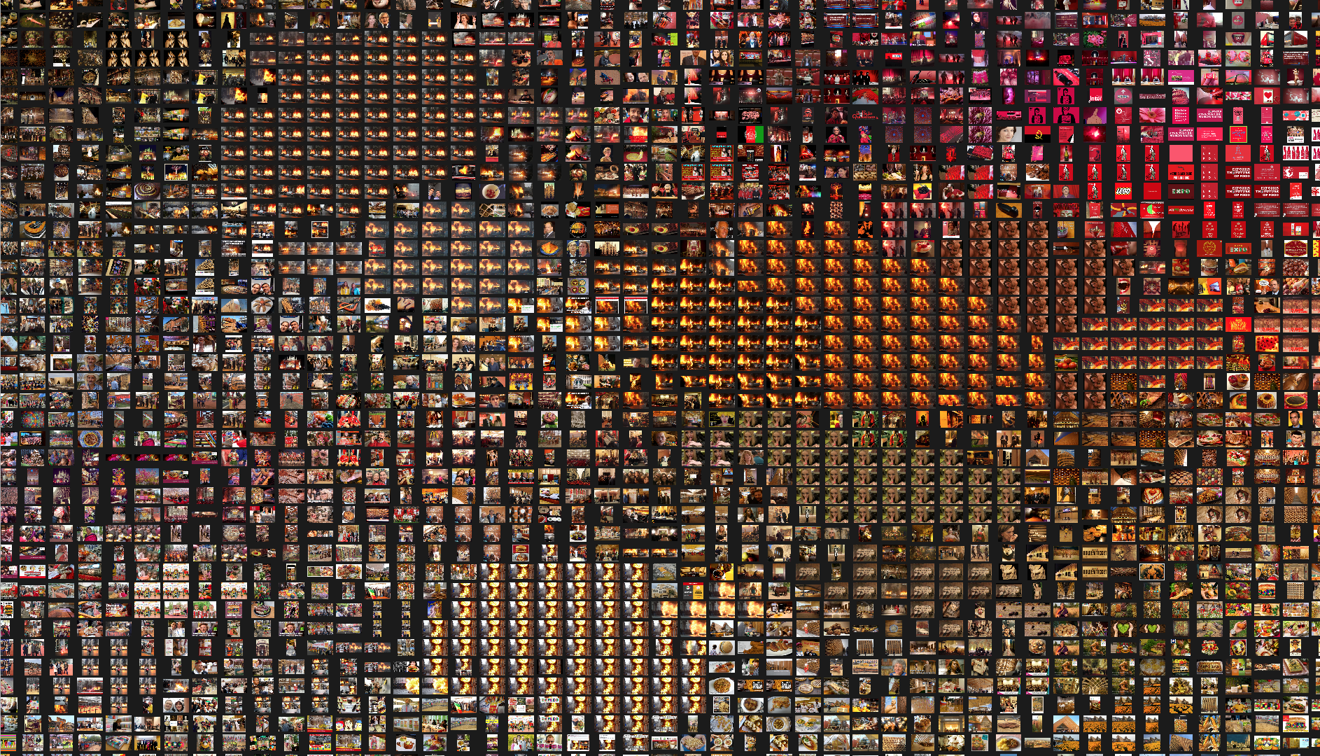
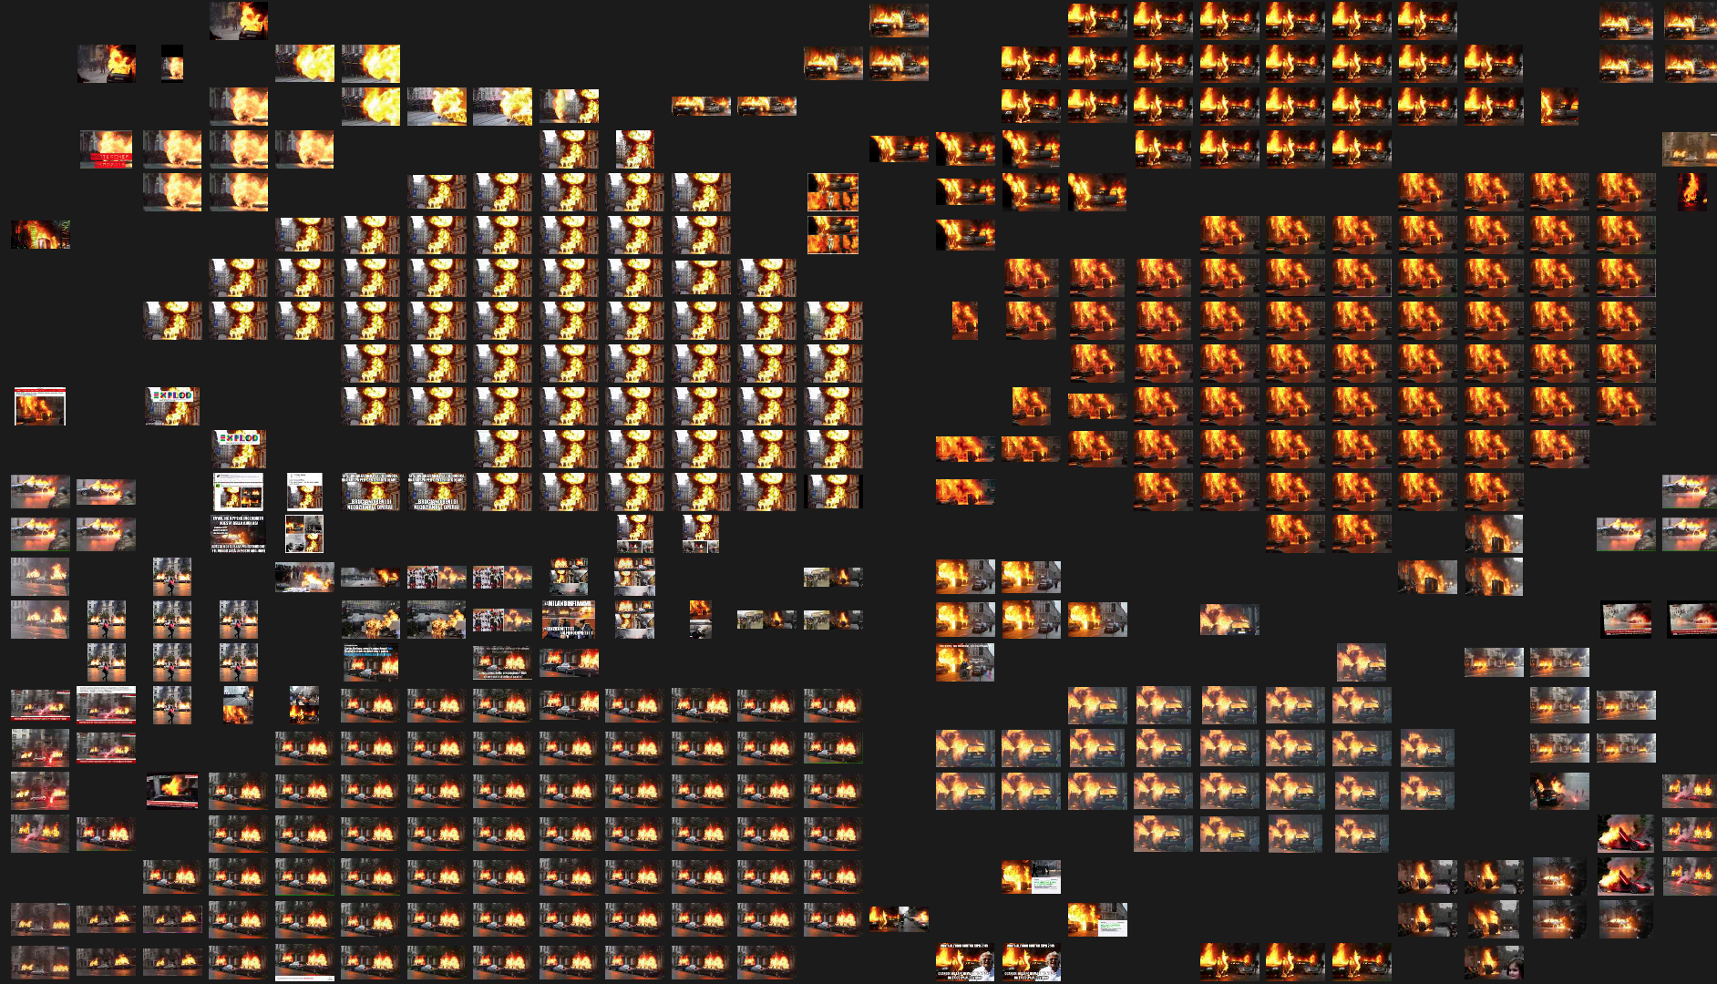
two approaches
VISUAL ATTRIBUTES ANALYSIS
CONTENT ANALYSIS
Image sorter
Clarifai API Interface
Notes:
What if we do Content Analysis

Slide 5
what image sorter does
ImageSorter is an image browsing app which allows an automatic sorting of images
Google Chrome
Tab Save
Google Image Extractor
Image Sorter
Excel

Slide 6
step by step
exercise
Introduction | ImageSorter | Clarifai

Slide 7
main steps
Google Image URLs extractor
Define a query for Google Images Search and grab links
Copy the links in a spreadsheet
Download images
Upload picture on Image Sorter and browse them
Notes:
You need five steps for creating an image sorter composition

Slide 8
main steps
Google Image URLs extractor
Define a query for Google Images Search
Copy the links in a spreadsheet
Download images
Upload picture on Image Sorter and browse them
Notes:
First of all you need a syste that allow you to download pictures from the web. Few years ago there was DownThemAll, but now is not more availble because of Firefox Browser updating.
We will grab links and then pictures from these links.
You can find on the presentation the link to this page. You should click there and then right click on the button, and copy the link in your bookmarks bar.

Slide 9
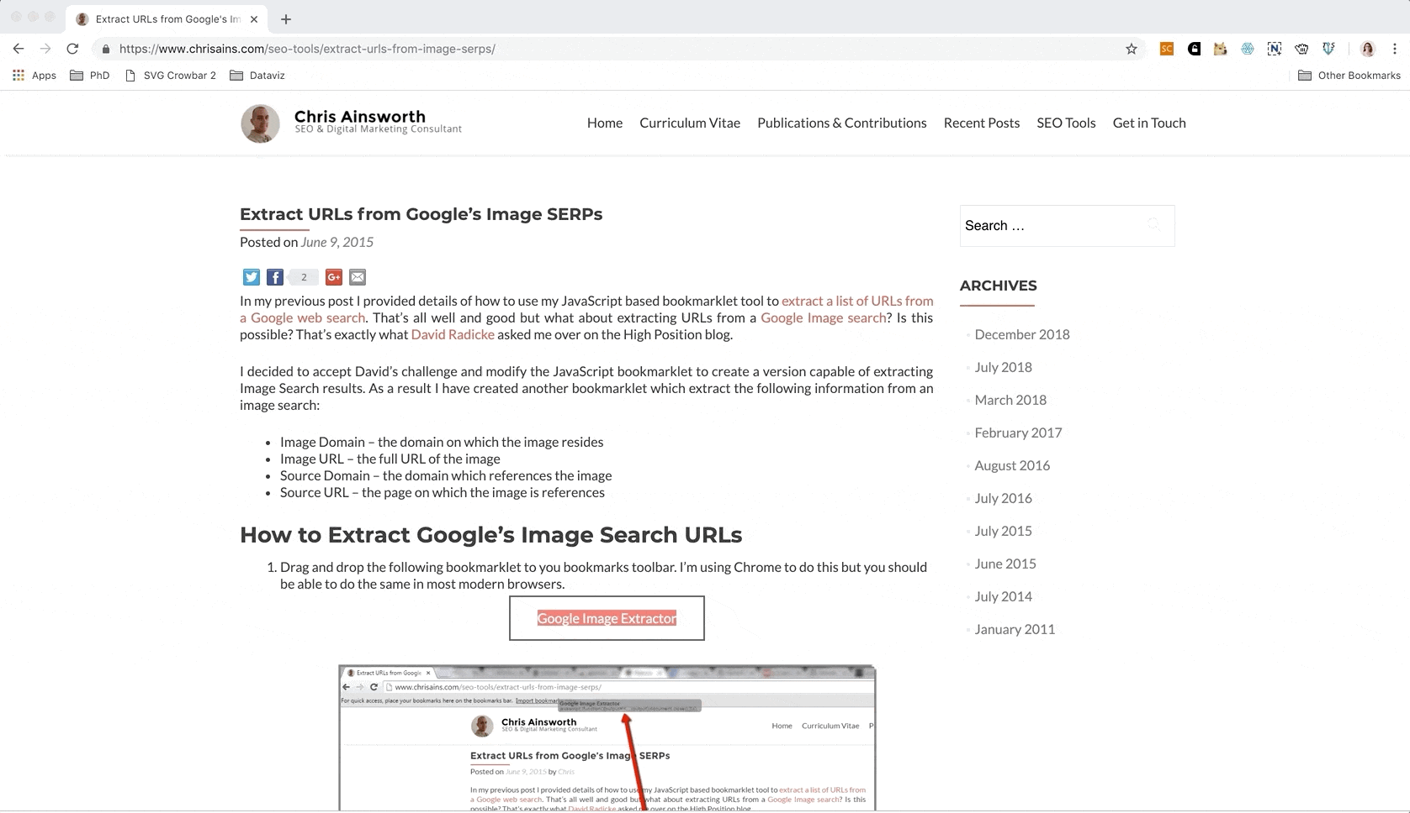
google image extractor
Notes:
First of all you need a system that allow you to download picture from the web. Few years ago there was DownThemAll, but now is not more available because of Firefox Browser updating.
We will grab links and then pictures from these links.
You can find on the presentation the link to this page. You should click there and then right click on the button, and copy the link in your bookmarks bar.

Slide 10
main steps
Google Image URLs extractor
Define a query for Google Images Search and grab links
Copy the links in a spreadsheet
Download images
Upload picture on Image Sorter and browse them
Notes:
Then you need a query

Slide 11
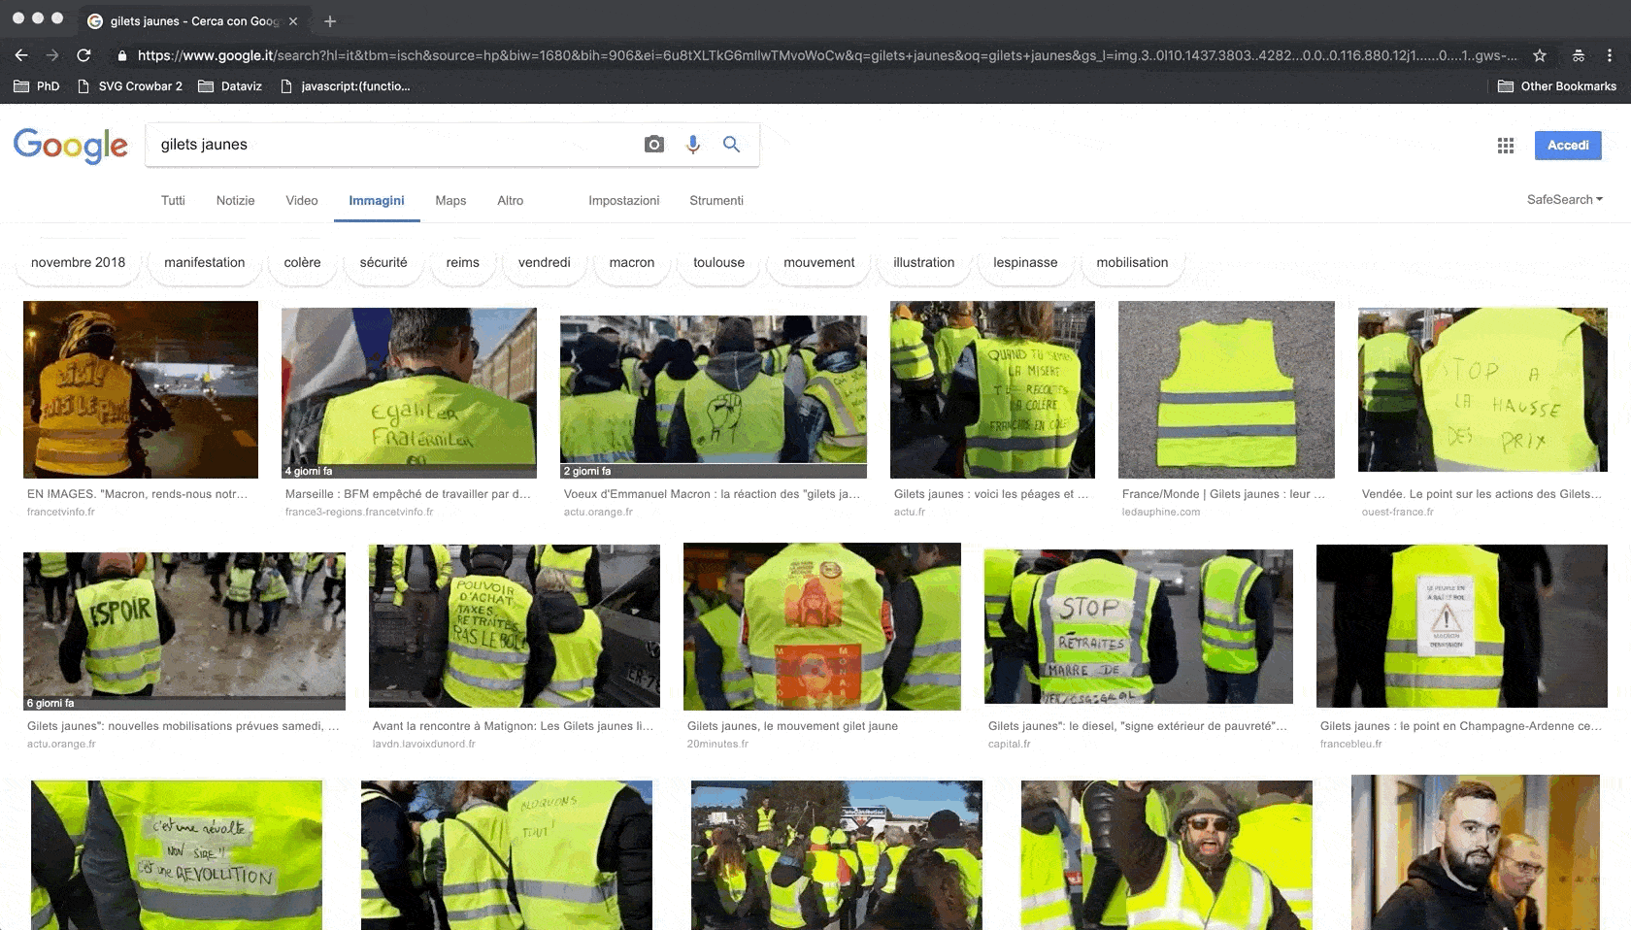
incognito mode google chrome
Notes:
Be careful and remind that a good research is done in incognito mode. Wrute down your query, like “jilet jaunes” and when you have enough results, click on your new nbookmark for grabbing the urls.

Slide 12
main steps
Google Image URLs extractor
Define a query for Google Images Search
Copy links in a spreadsheet
Download images
Upload picture on Image Sorter and browse them
Notes:
You can create visualization on rawgraphs following five or six easy steps.
First of all you need a dataset, copy and paste it in the online tool, select a visual model, map your data according to different visuali variables, export the results in svg or png format and if you can, edit it in Illustrator.

Slide 13
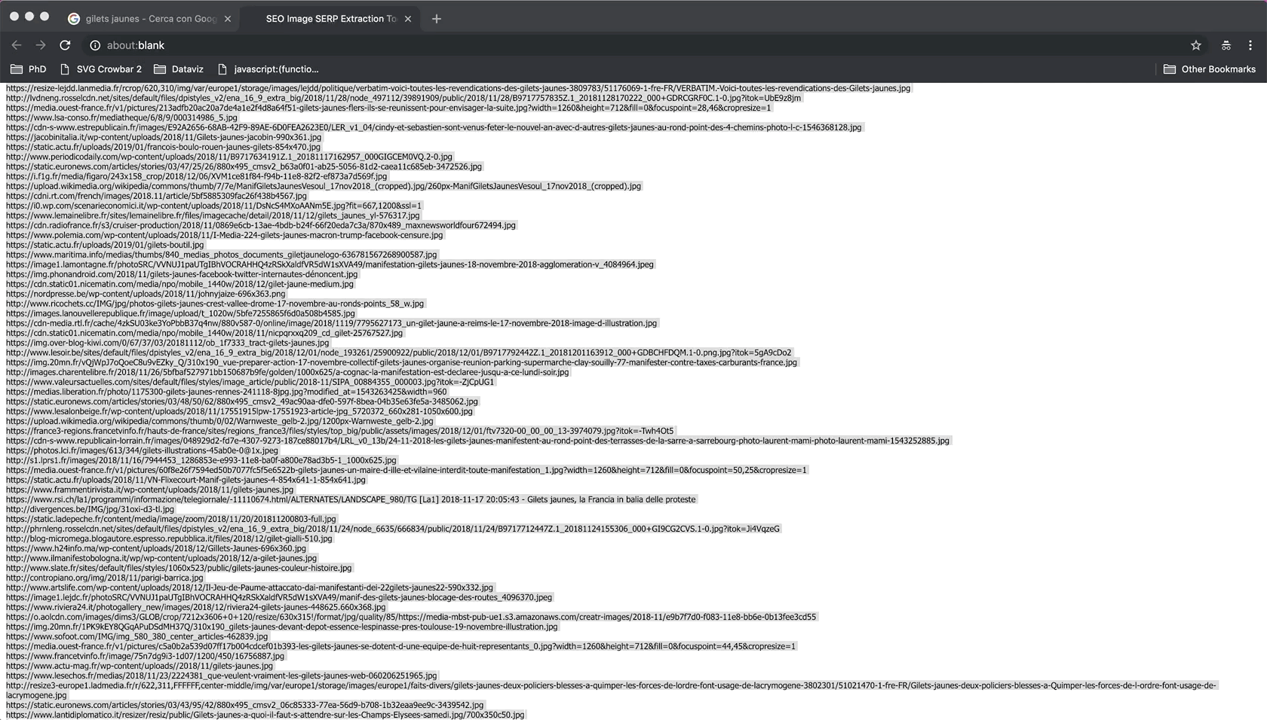
excel / google spreadsheets
Notes:
Copy and paste the results on a spreadsheet

Slide 14
main steps
Google Image URLs extractor
Define a query for Google Images Search
Copy the links in a spreadsheet
Download images
Upload picture on Image Sorter and browse them

Slide 15
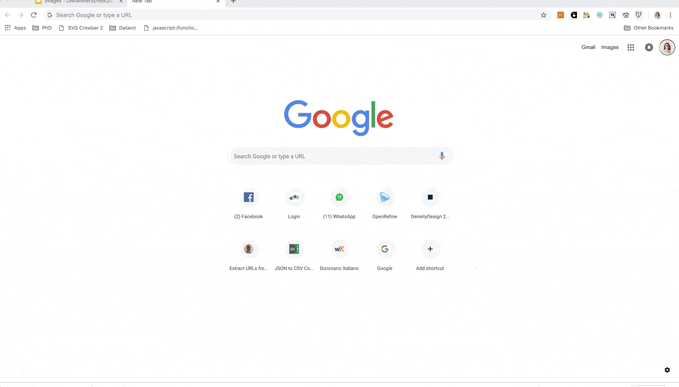
tabsave extension
Notes:
And download images by pasting the links in the TabSave window (The Extension that you should have downloaded). It will downalod pictuer in a folder (if no, put all the images in a folder)

Slide 16
main steps
Google Image URLs extractor
Define a query for Google Images Search
Copy the links in a spreadsheet
Download images
Upload picture on Image Sorter and browse them

Slide 17
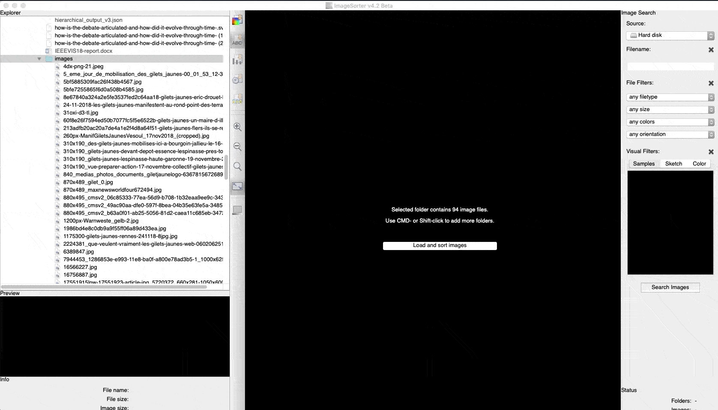
image sorter
Notes:
Open Image sorter and upload your folder of images.

Slide 18
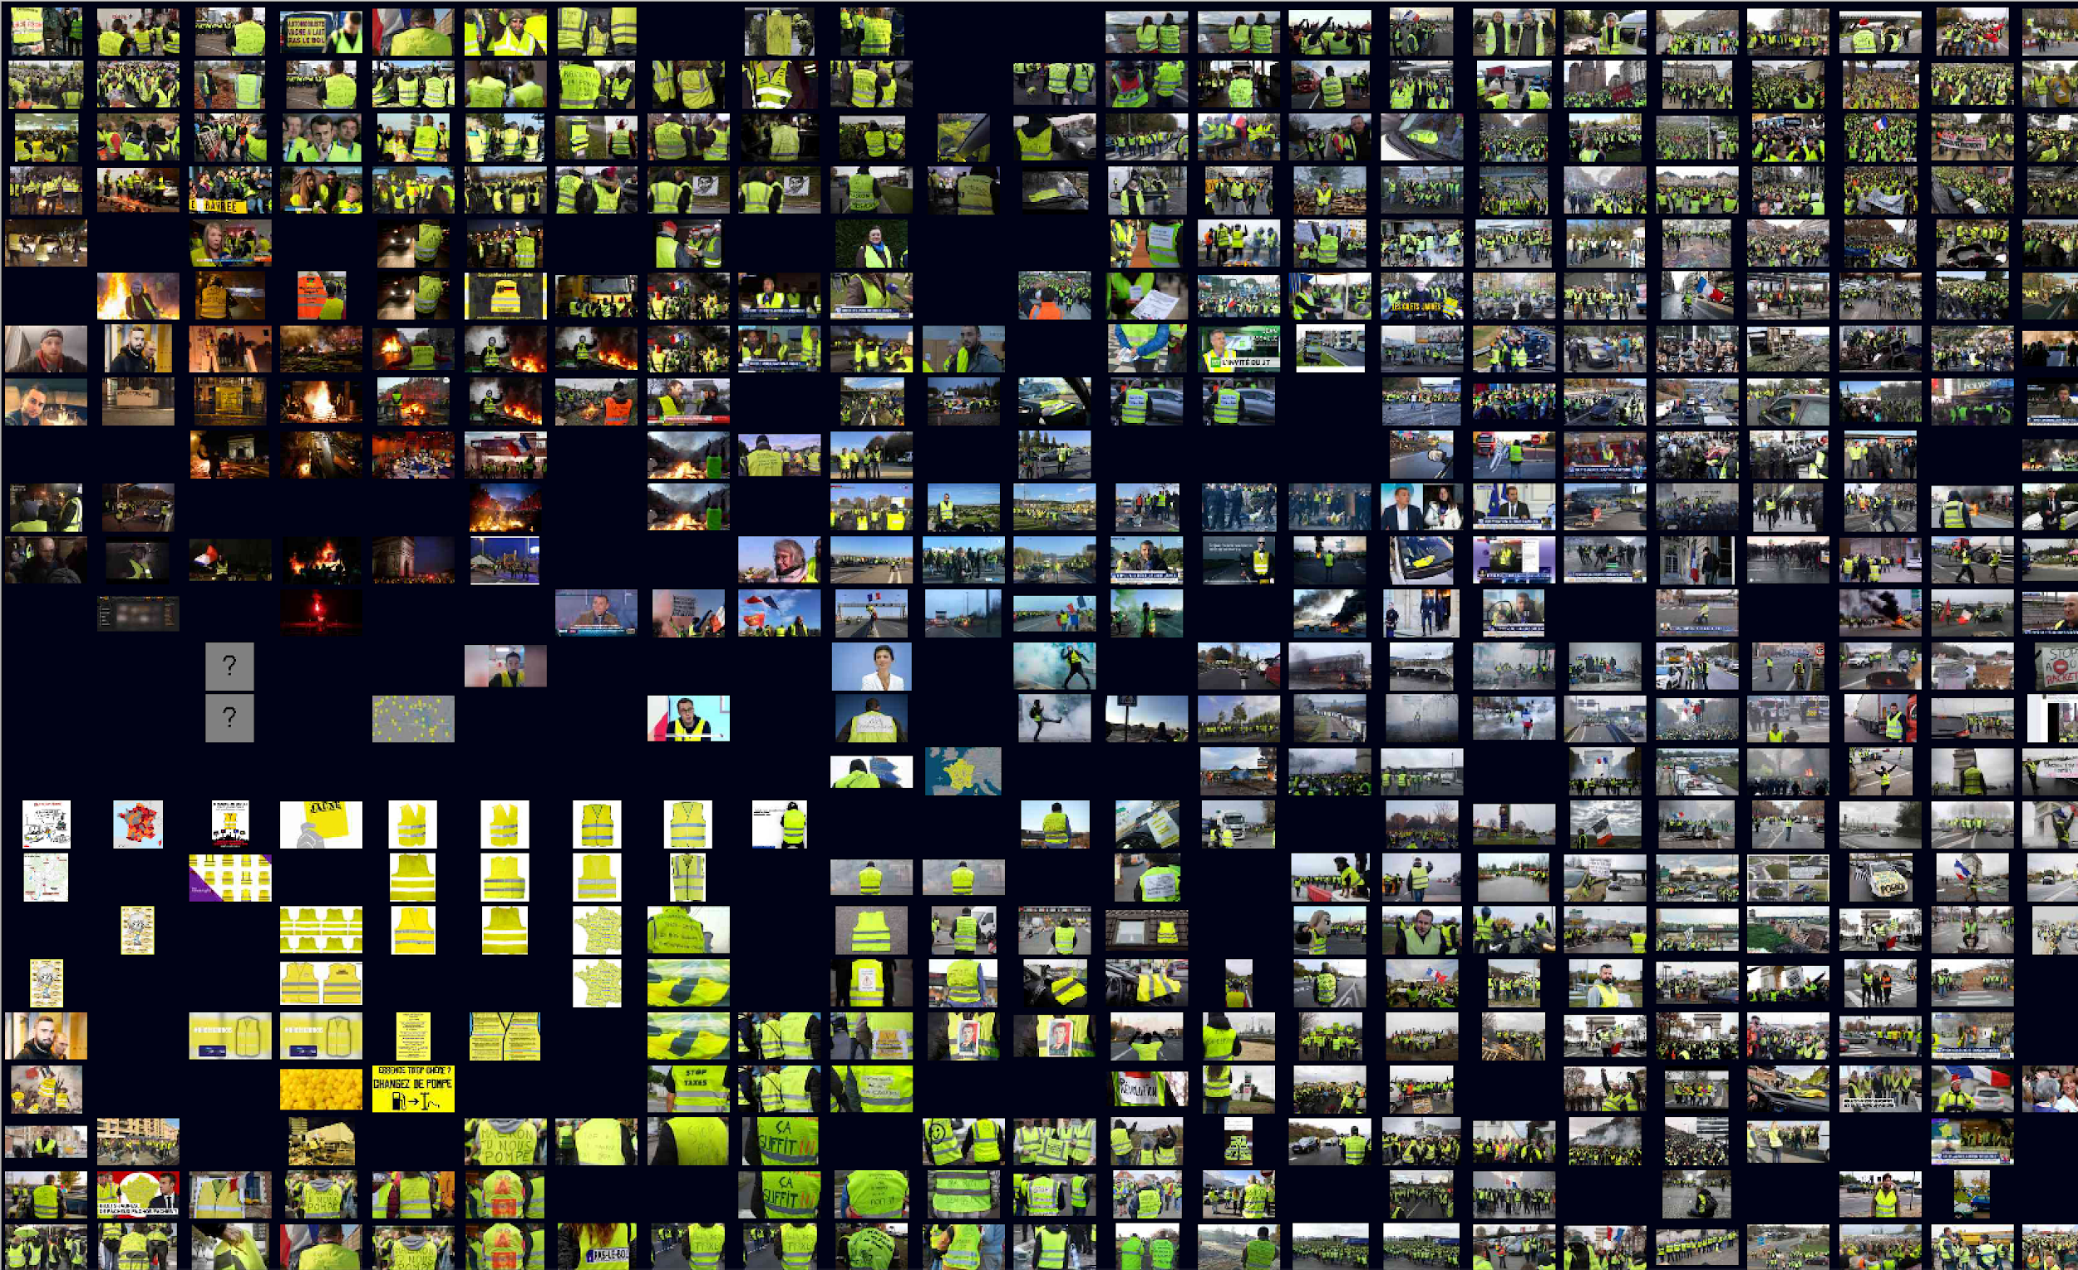
Notes:
Sort them by color and find a similarities.
It’s not possible to downalod a sull picture of the results, but you can easily make a screenshot and change the background.

Slide 19
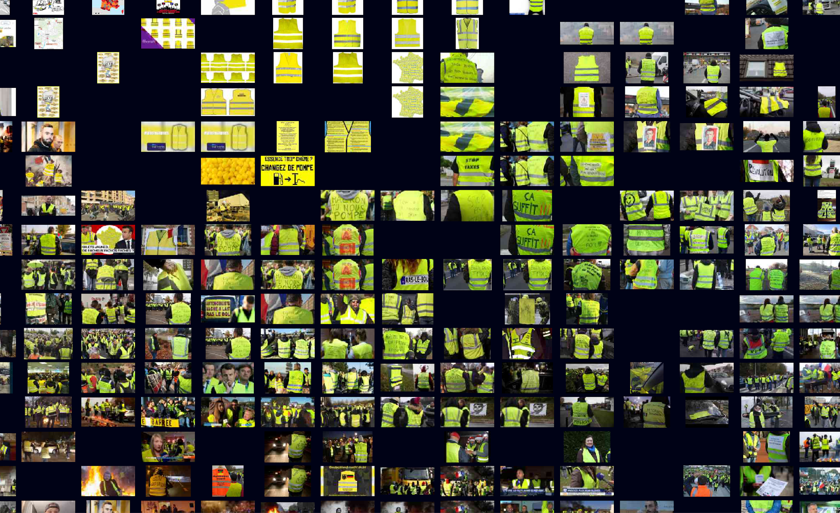

Slide 20
two approaches
VISUAL ATTRIBUTES ANALYSIS
CONTENT ANALYSIS
Image sorter
Clarifai API Interface
Notes:
What if we do Content Analysis

Slide 21
what a clarifai interface does
Takes a list of images (in the form of urls) and outputs what an algorithm, also called a model, "sees" in these images
Notes:
Clarifai is a computer vision platform that recognizes the content of images. We will use the same group of images from google images we will use a clarifai interface that enables you to tag more picture at the same time.

Slide 22
main steps
Image Tagging tool interface
Create a CSV with images urls (with header, any string)
Copy and paste API KEY (previously created)
Drag&drop the .CSV file with urls
Run
Download the data and import it in the spreadsheet
Explore the data

Slide 23
step by step
exercise
Introduction | ImageSorter | Clarifai

Slide 24
main steps
Image Tagging tool interface
Create a CSV with images urls (with header, any string)
Copy and paste API KEY (previously created)
Drag&drop the .CSV file with urls
Run
Download the data and import it in the spreadsheet
Explore the data

Slide 25
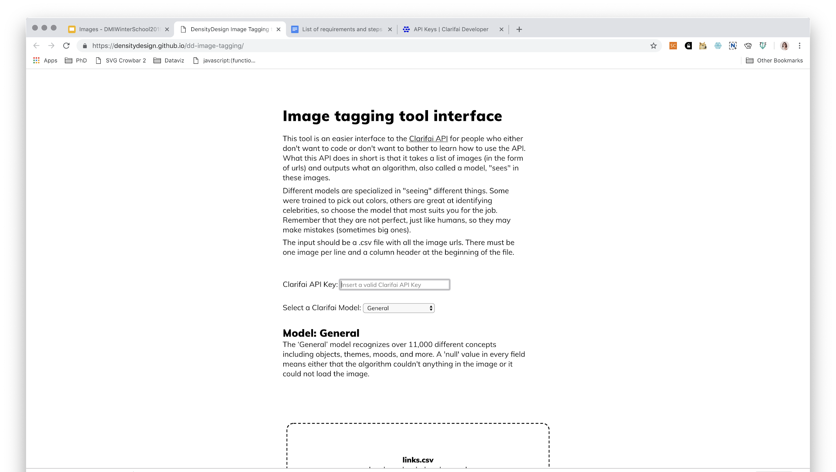
image tagging tool interface

Slide 26
main steps
Image Tagging tool interface
Create a CSV with images urls (with header, any string)
Copy and paste API KEY (previously created)
Drag&drop the .CSV file with urls
Run
Download the data and import it in the spreadsheet
Explore the data

Slide 27
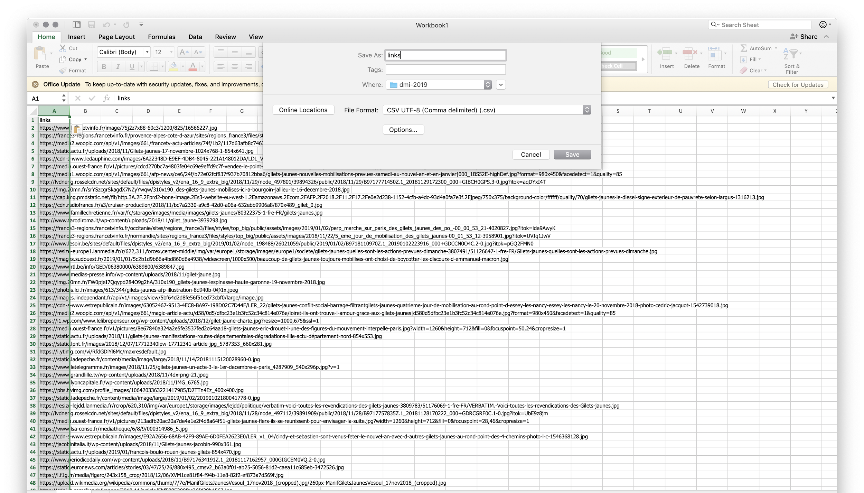
save the URLs list as .csv

Slide 28
main steps
Image Tagging tool interface
Create a CSV with images urls (with header, any string)
Copy and paste API KEY (previously created)
Drag&drop the .CSV file with urls
Run
Download the data and import it in the spreadsheet
Explore the data

Slide 29
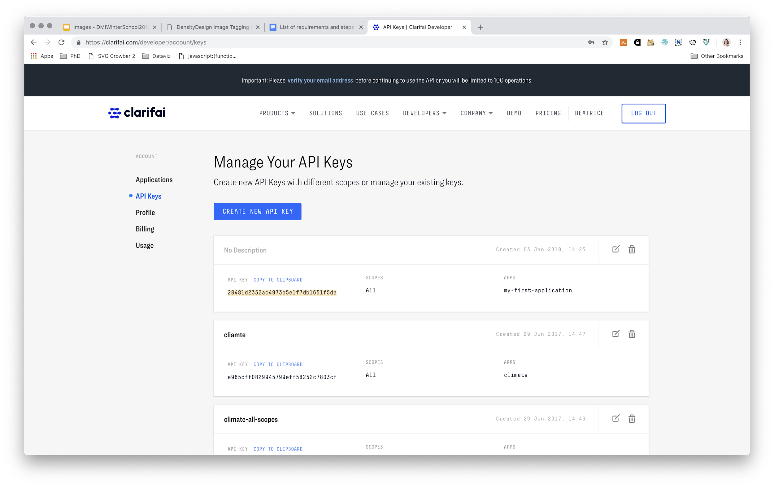
copy and paste the API Key

Slide 30
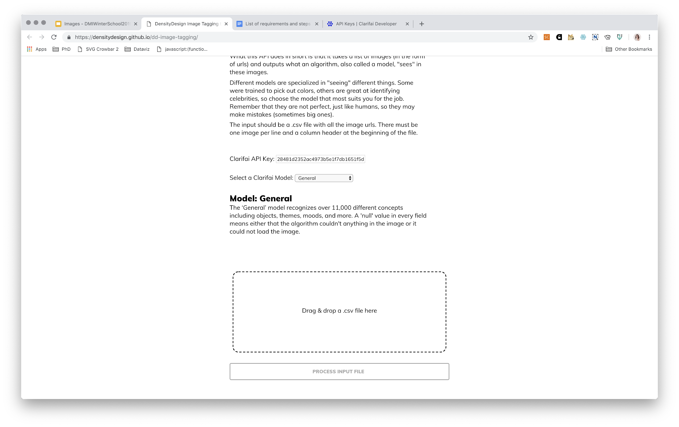
COPY AND PASTE YOUR API KEY

Slide 31
main steps
Image Tagging tool interface
Create a CSV with images urls (with header, any string)
Copy and paste API KEY (previously created)
Drag&drop the .CSV file with urls
Run
Download the data and import it in the spreadsheet
Explore the data
Notes:
We are now focusing on the first step, the most important one.

Slide 32
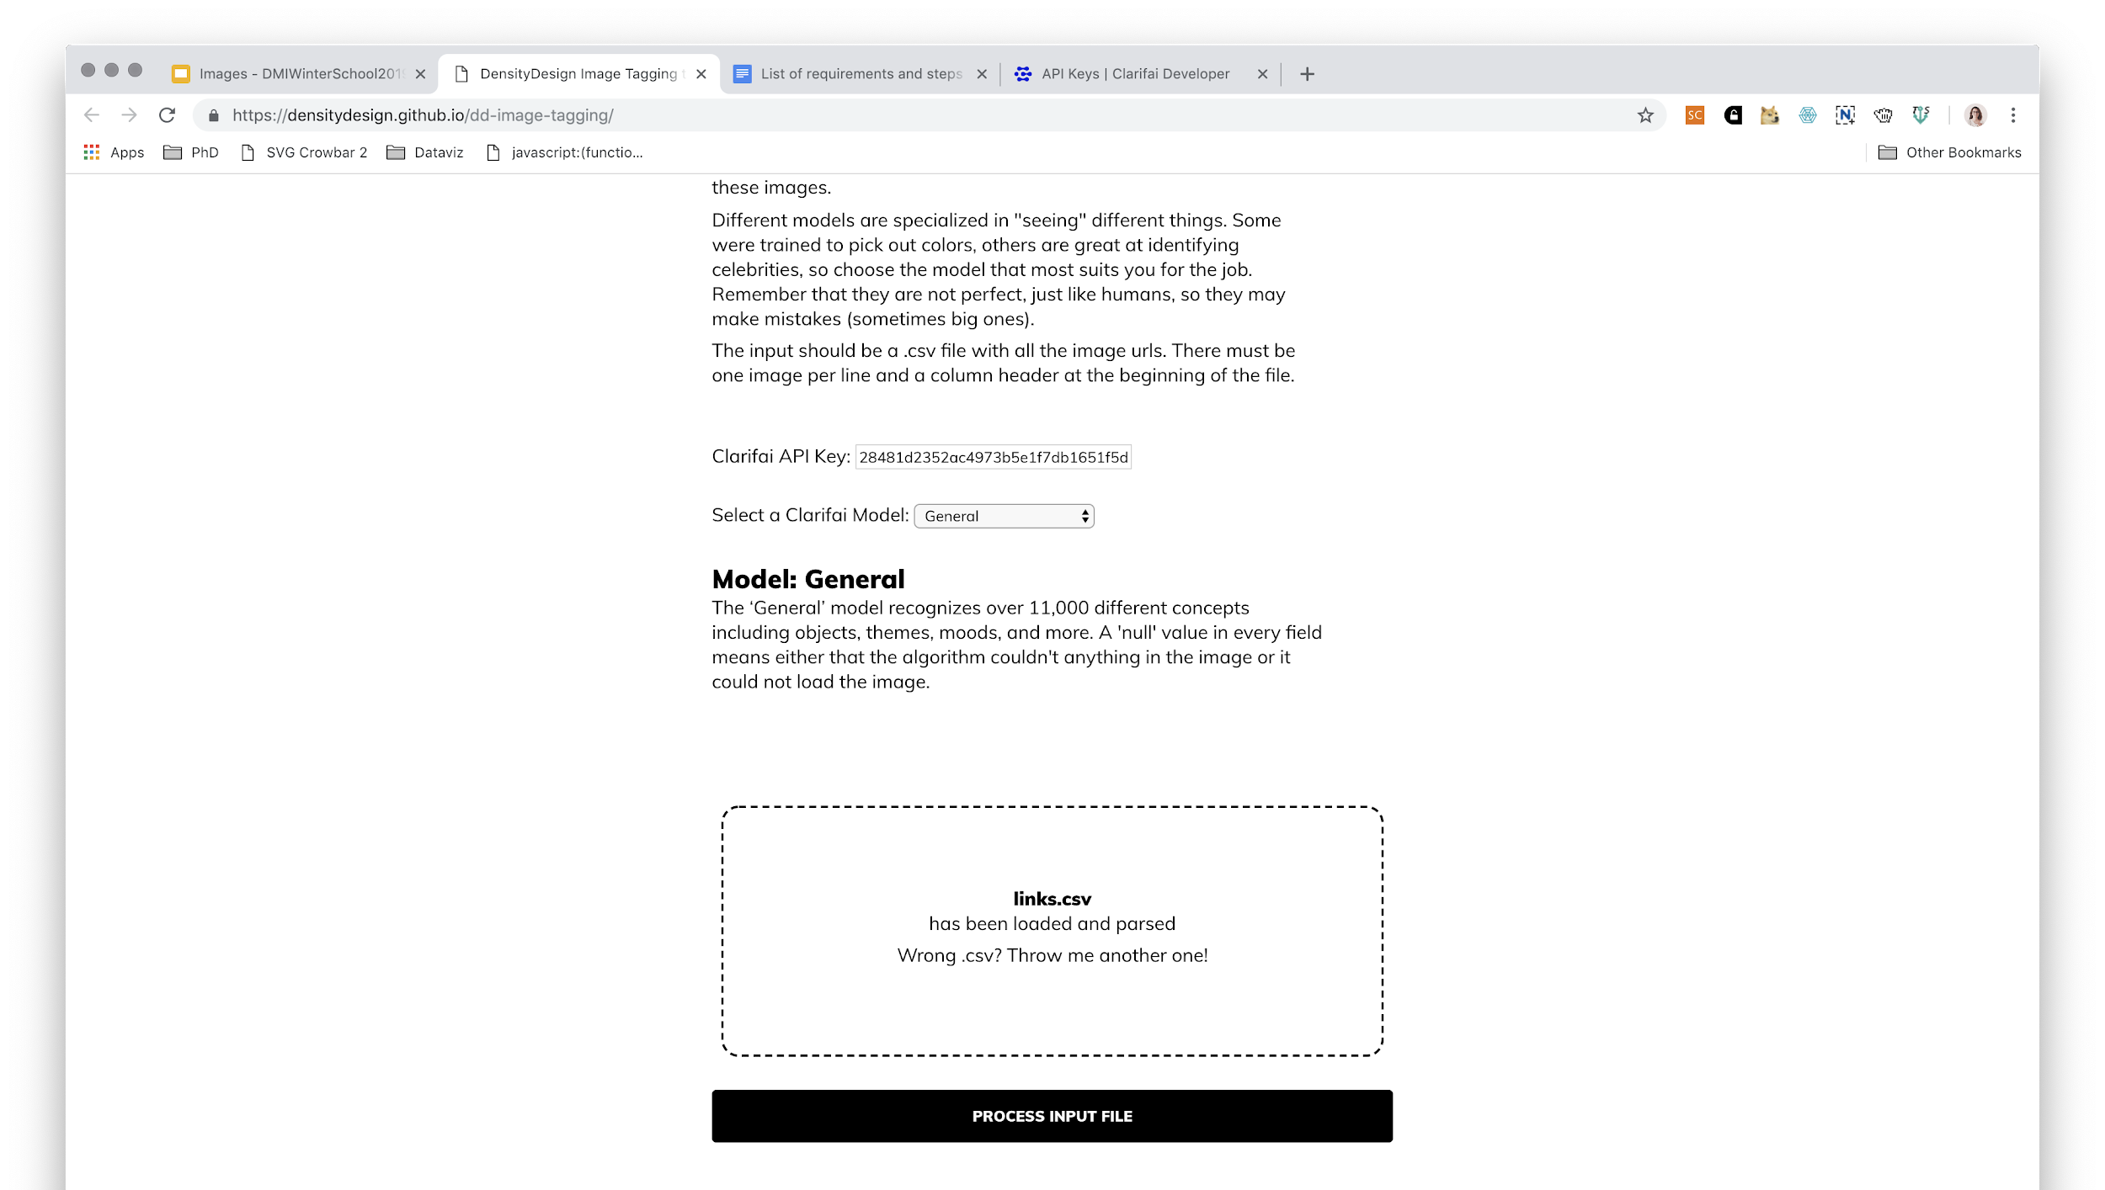
Drag and drop the csv file

Slide 33
main steps
Image Tagging tool interface
Create a CSV with images urls (with header, any string)
Copy and paste API KEY (previously created)
Drag&drop the .CSV file with urls
Run
Download the data and import it in the spreadsheet
Explore the data

Slide 34
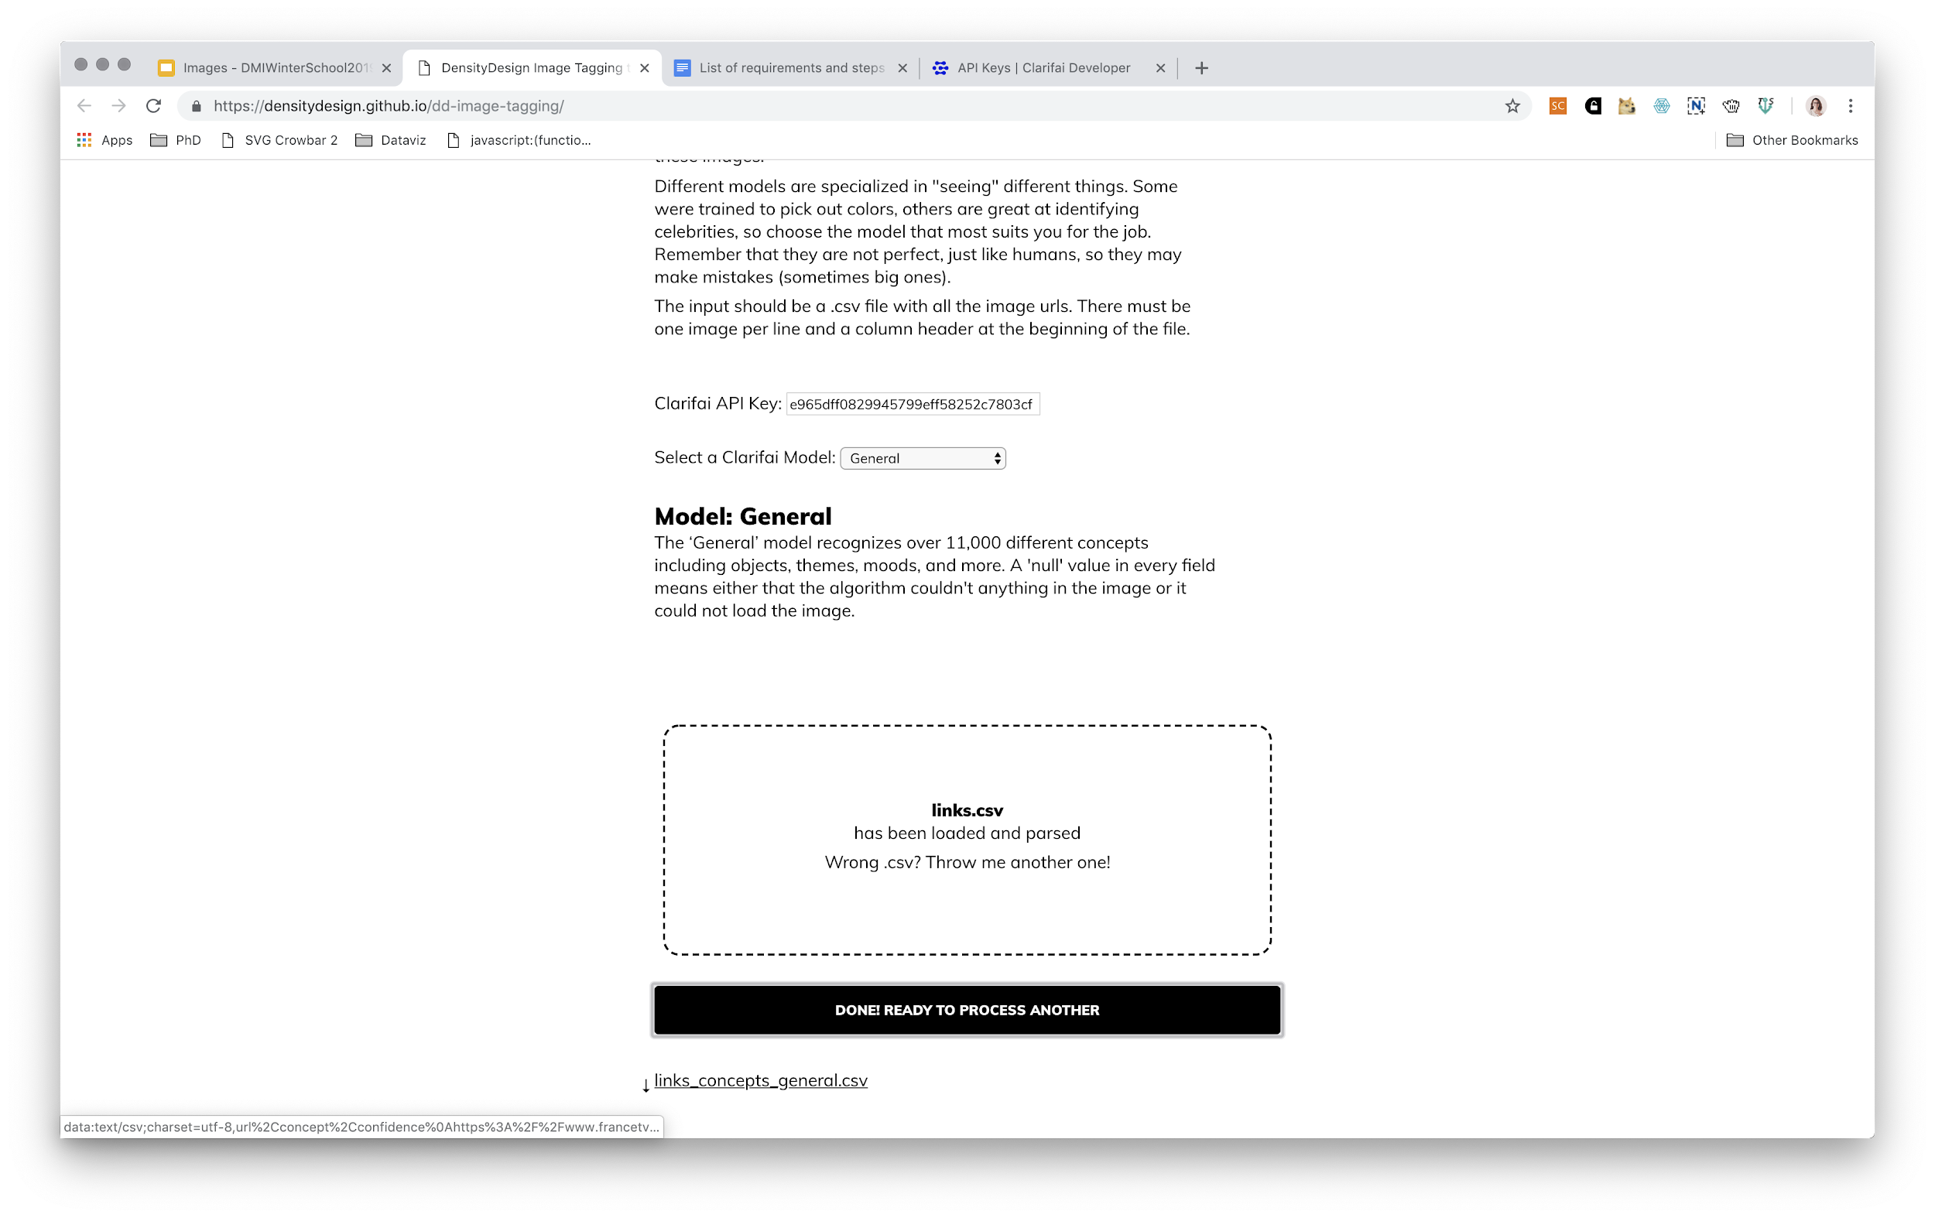
run the model

Slide 35
main steps
Image Tagging tool interface
Create a CSV with images urls (with header, any string)
Copy and paste API KEY (previously created)
Drag&drop the .CSV file with urls
Run
Download the data and import it in the spreadsheet
Explore the data

Slide 36
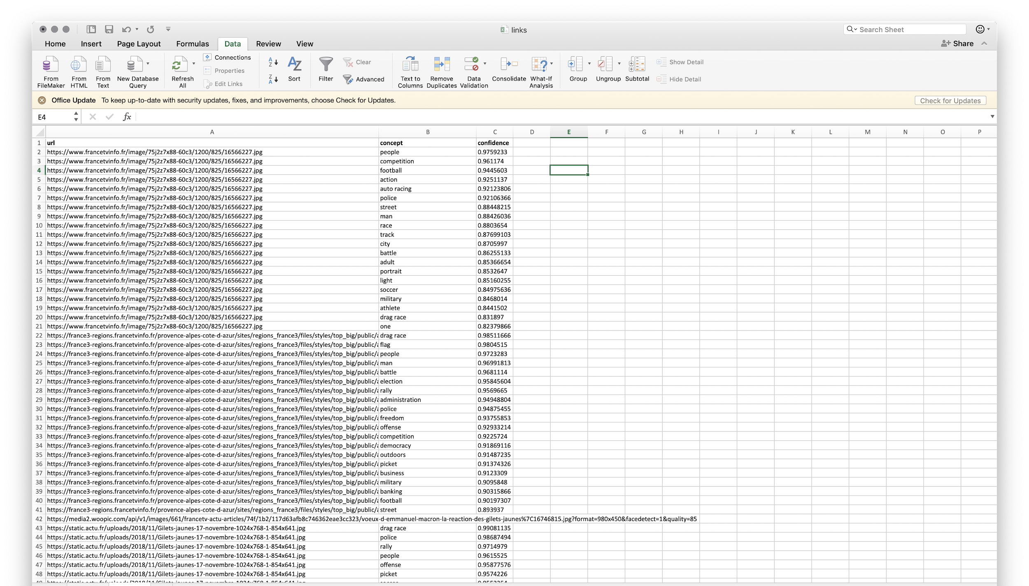
import data in a spreadsheet

Slide 37
main steps
Image Tagging tool interface
Create a CSV with images urls (with header, any string)
Copy and paste API KEY (previously created)
Drag&drop the .CSV file with urls
Run
Download the data and import it in the spreadsheet
Explore the data

Slide 38
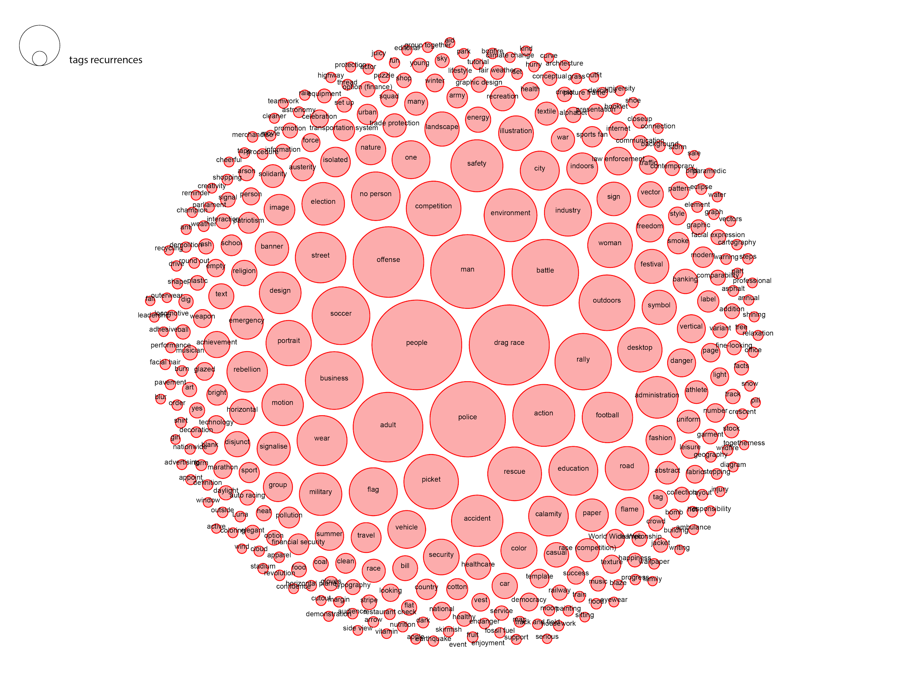

Slide 39
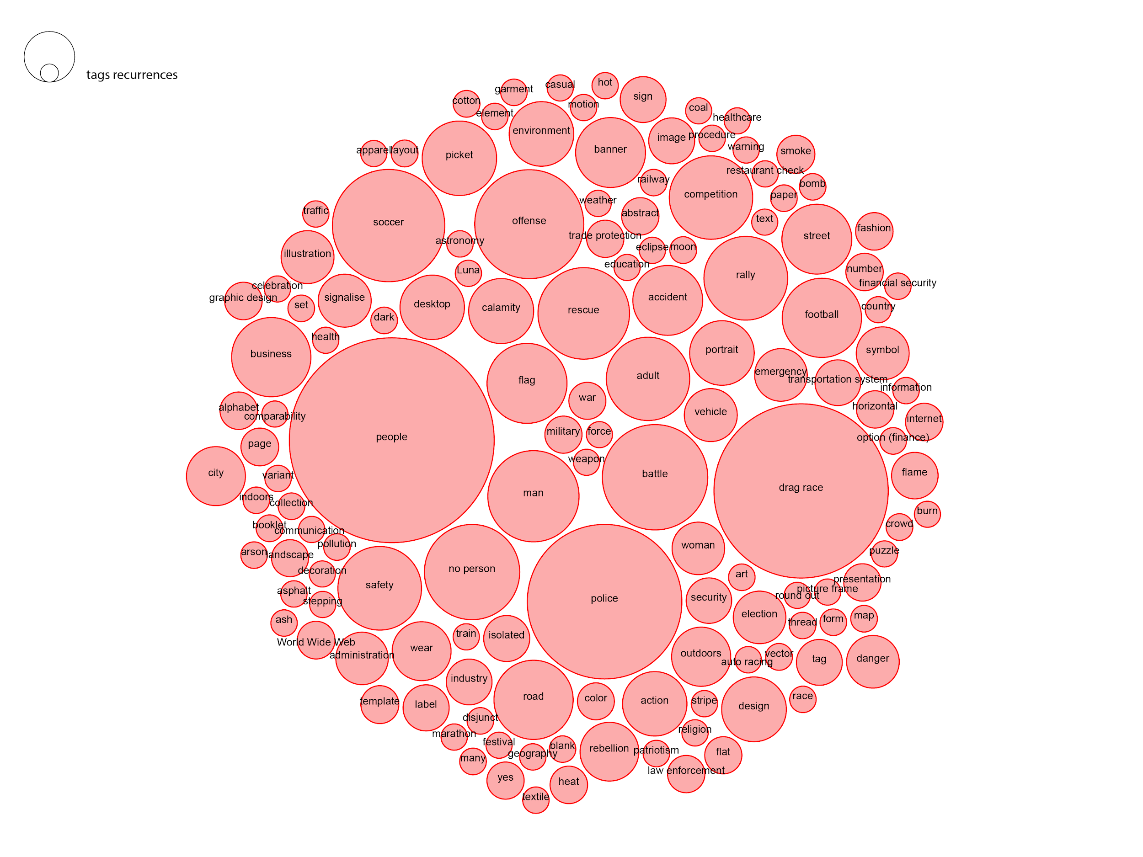
> 0.94
Notes:
> than 0.94

Slide 40
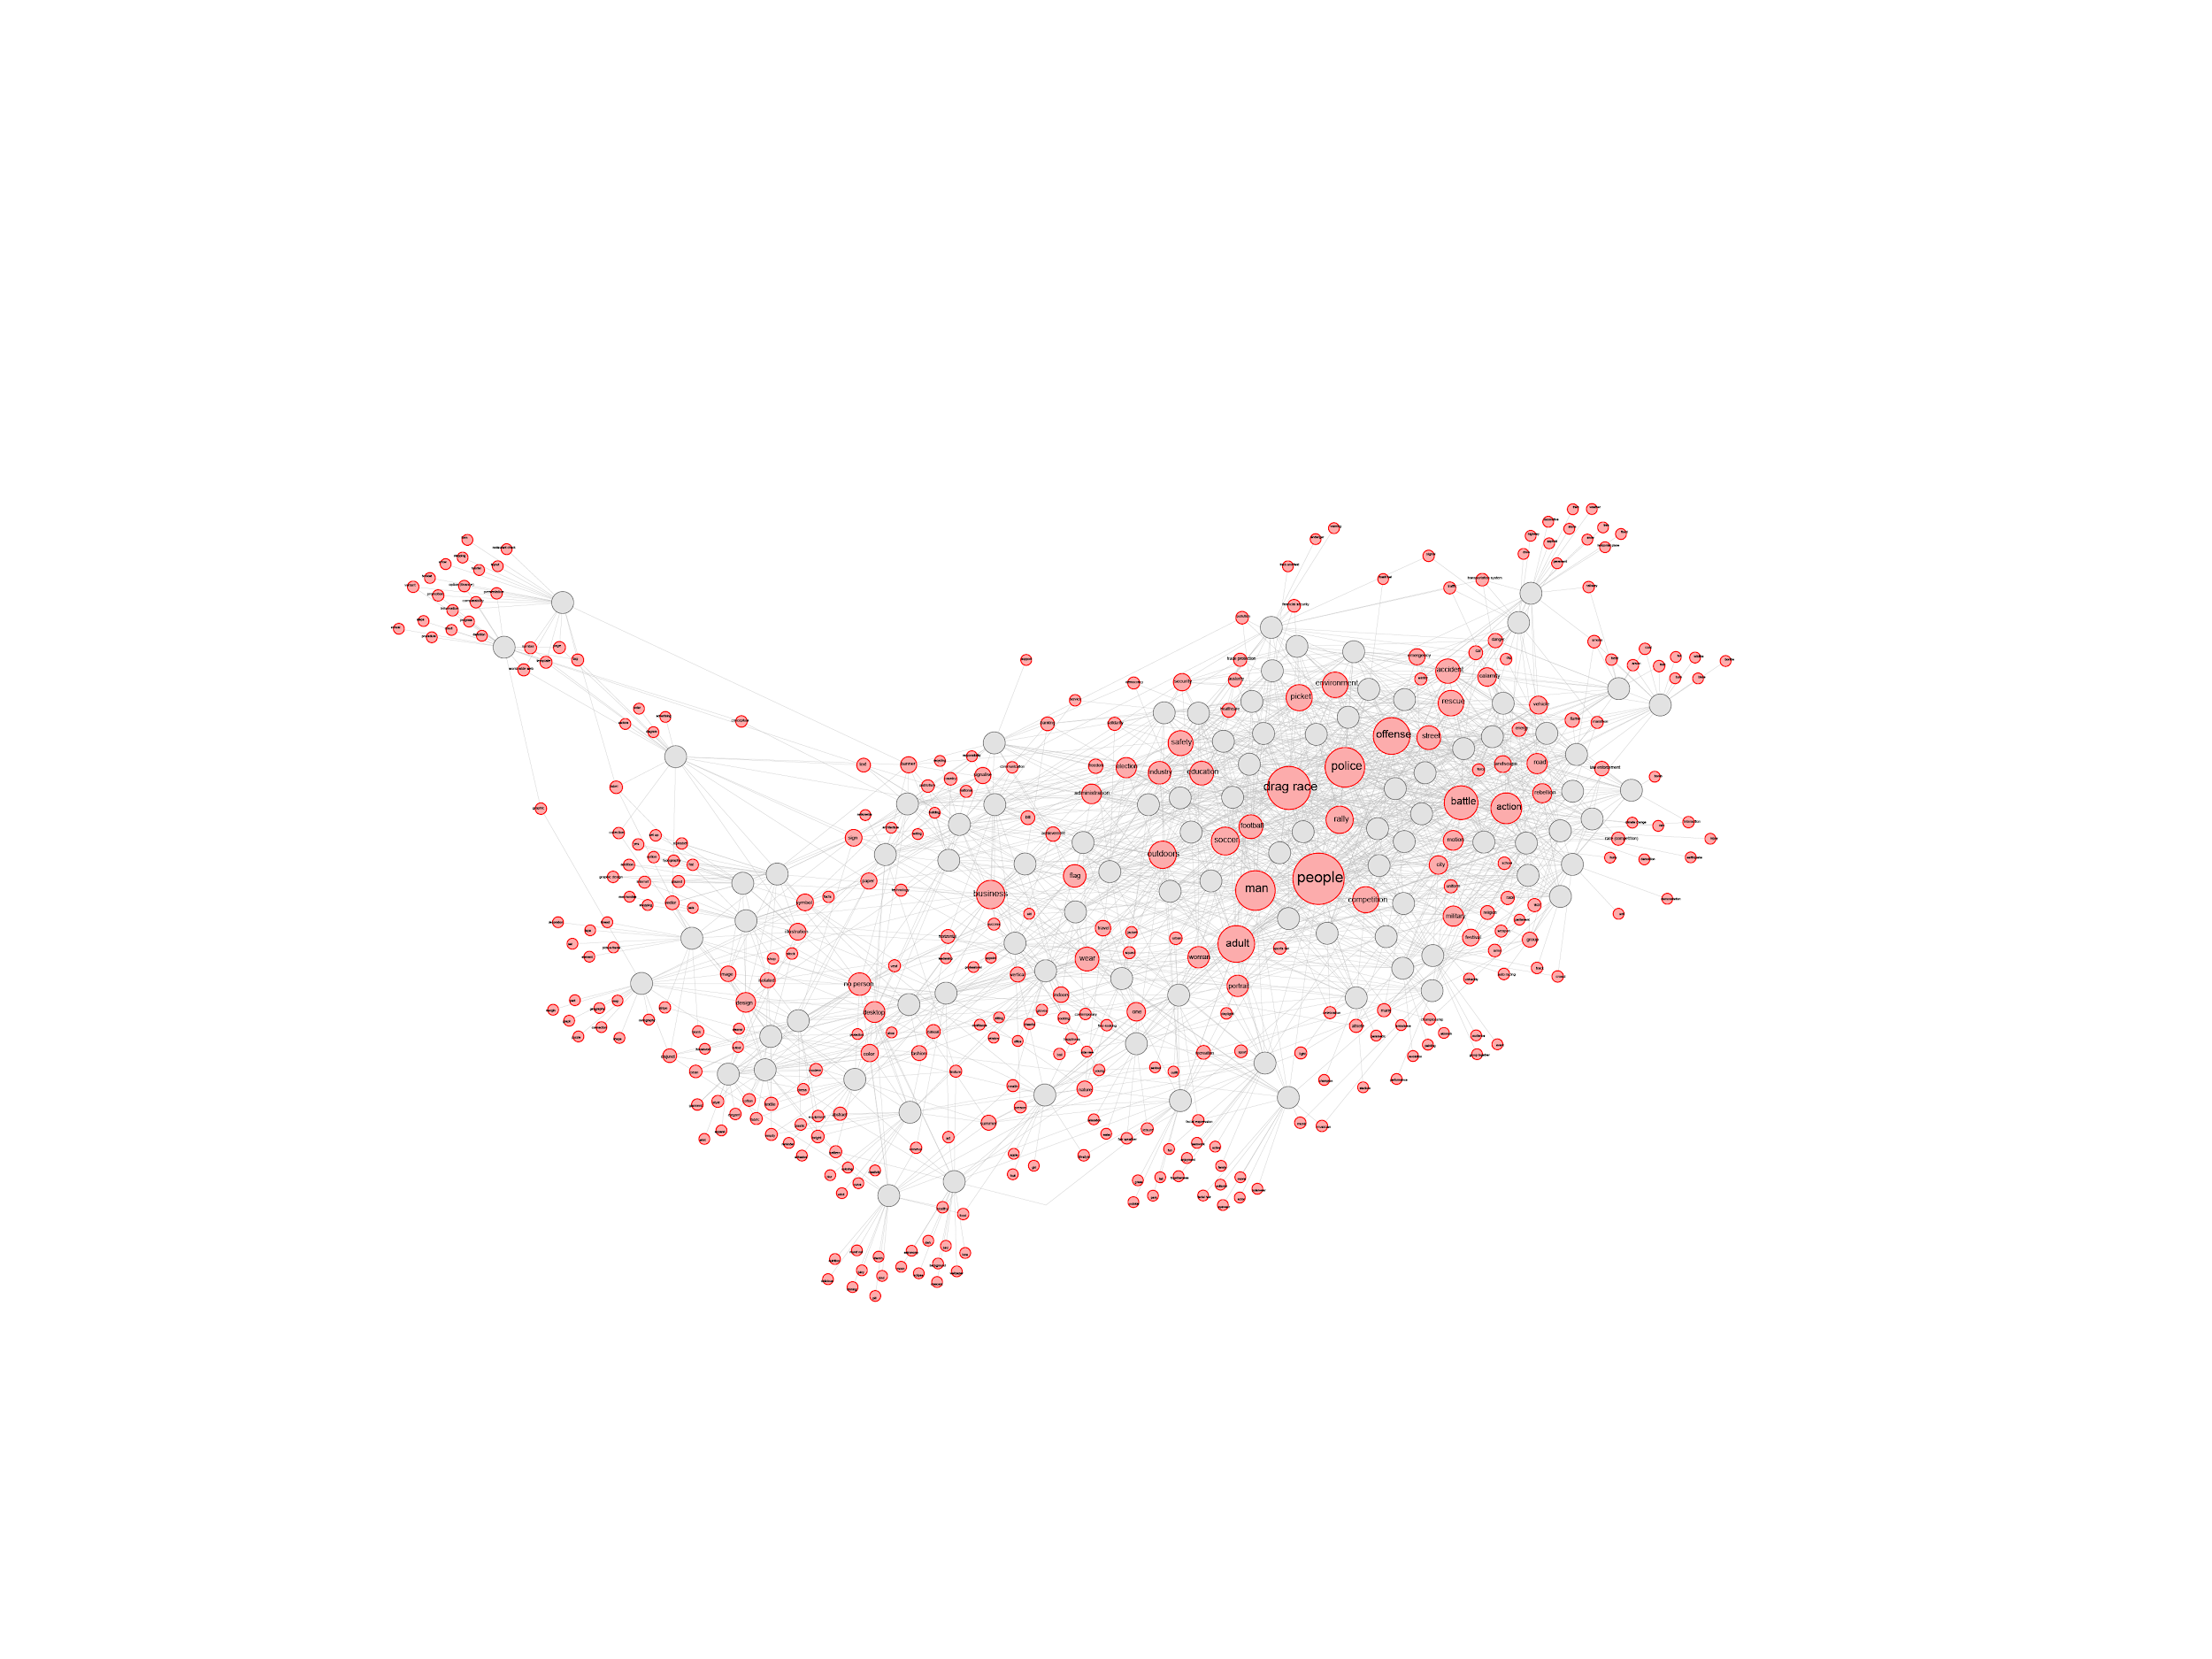

Slide 41
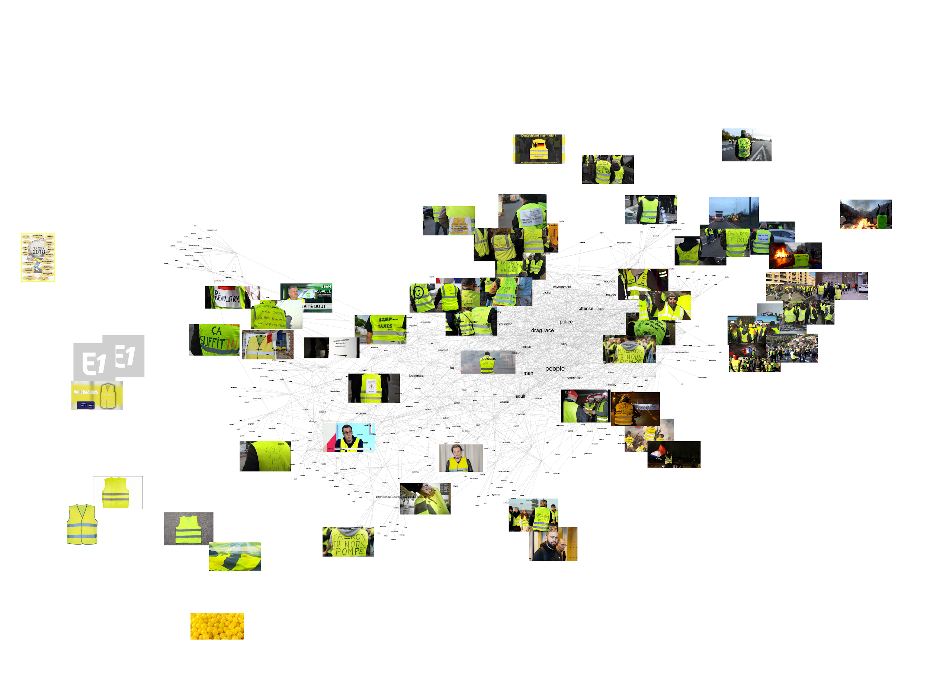

Slide 42
let’s play
Introduction | ImageSorter | Clarifai

Slide 43
https://bit.ly/2IlJZ52
Introduction | ImageSorter | Clarifai

